Slide 1
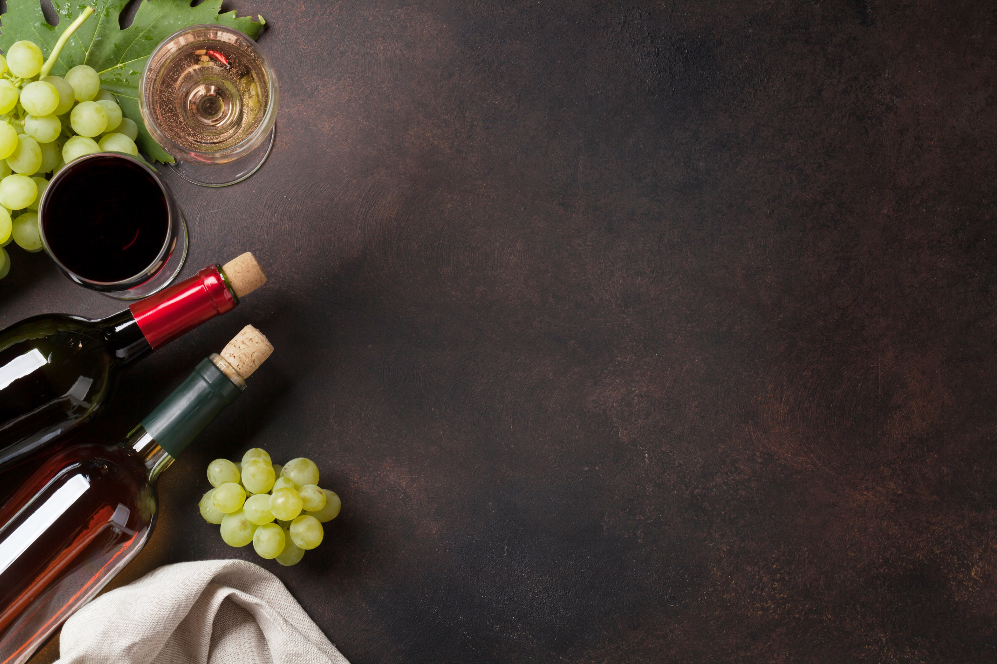
Hakuna Moscato, a Project to Determine Wine Quality
Cameron Farquhar
Yuri Groza
Beth Myers
Jimmy White
Kurt Dietrich
Jared Nieves

Slide 2
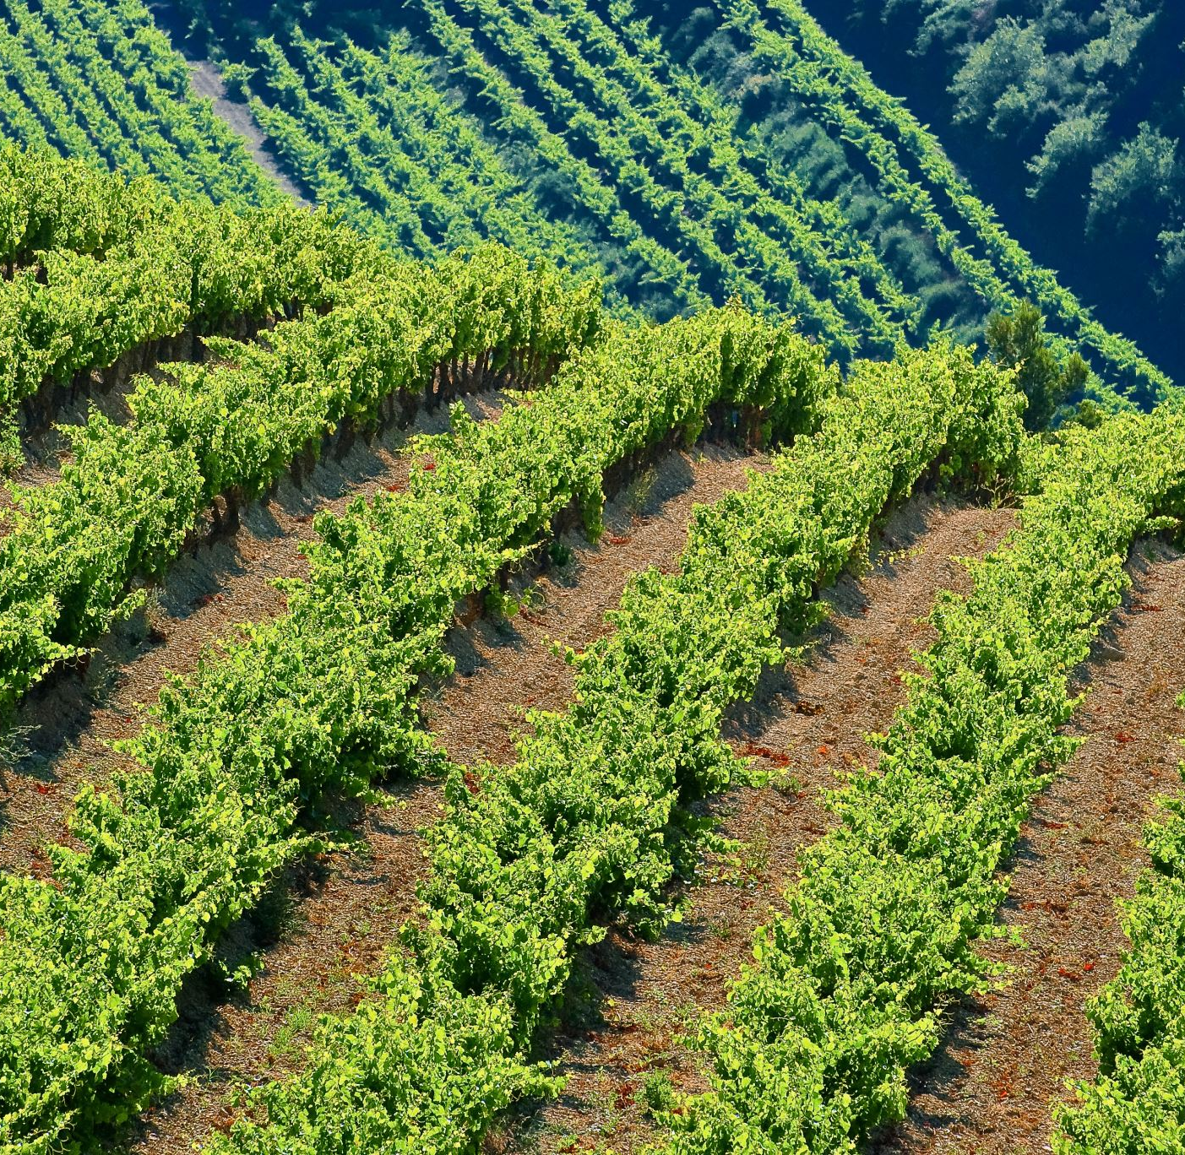
What elements determine a quality wine?
Balance – between sweetness, acidity, tannin,
and alcohol
Length – taste across the tongue
Depth – subjective, versus flat
Complexity – multiple aromas and flavors
Finish – aftertaste
Typicity – measure true to type

Slide 3
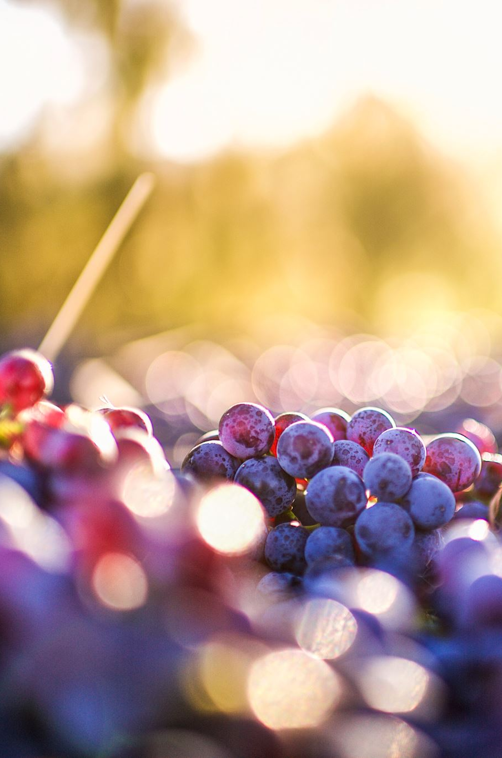
What we wanted to learn
What is the average cost of wine by country?
What type of wine is more popular – Red or White?
What regions / countries produce the ‘best’ wines?

Slide 4
